Slide 1
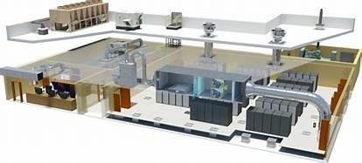
01 - Data center facility requirement.
Design for NEST 256 Humber Program.

Slide 2


Contents
 Data Center Design Philosophy
 Data Center Design Criteria
 Designing a Data Center
 Determining Data Center Capacities
 Site Selection
 Power Distribution
 Network Cabling Infrastructure
 Avoiding Hazards
 Fire Suppression Systems
 Managing system configuration
2

Slide 3

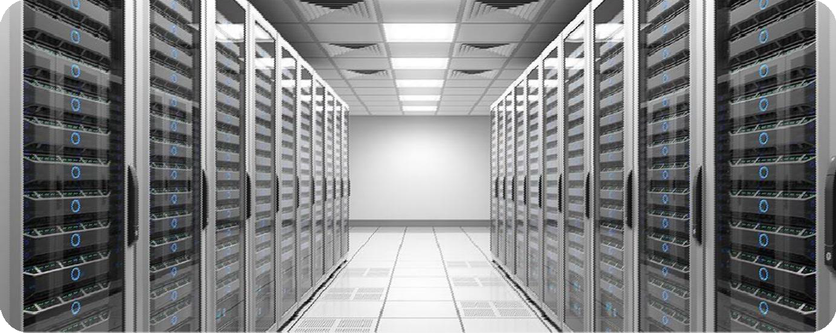
What is a data center?
3
A data center is a facility used to house computer systems and associated components, such as telecommunications and storage systems. It generally includes redundant or backup power supplies, redundant data communications connections, environmental controls (e.g., air conditioning, fire suppression) and various security devices. Large data centers are industrial scale operations using as much electricity as a small town.

Slide 4
1.Data Center Design Philosophy
five core values that are the foundation of a data center design
philosophy:
 Simplicity
 flexibility
 scalability
 modularity
4

Slide 5

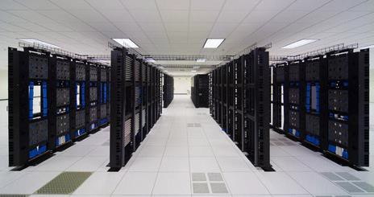
Simplicity
Keep the Design as Simple as Possible
A simple data center design is easier to understand and manage. A basic design makes it simple to do the best work and more difficult to do sloppy work. For example, if you label everything—network ports, power outlets, cables, circuit breakers, their location on the floor—there is no guess work involved.
5

Slide 6

Design for Flexibility
Nobody knows where technology will be in five years, but it is a good guess that there will be some major changes. Making sure that the design is flexible and easily upgradable is critical to a successful long-term design.
Part of flexibility is making the design cost- effective. Every design decision has an impact on the budget. Designing a cost effective data center is greatly dependent on the mission of the center. One company might be planning a data center for mission critical applications, another for testing large-scale configurations that will go into a mission critical data center.
6

Slide 7
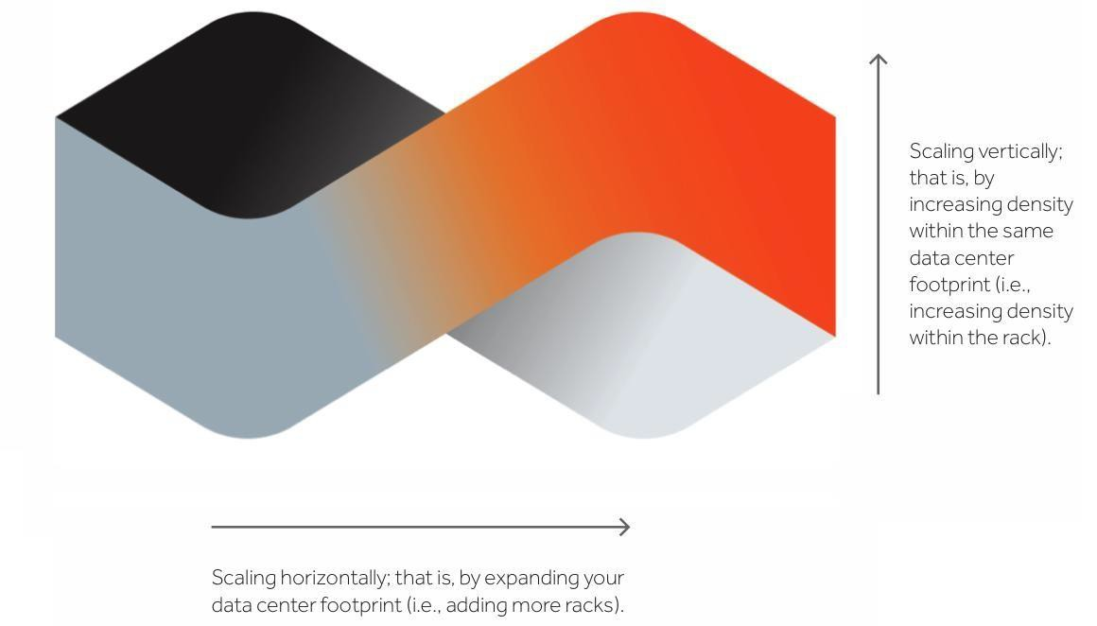
Scalability
 The design should work equally well for a 2,000,
20,000, or 2,000,000 square foot data center. Where a variety of equipment is concerned, the use of watts per square foot to design a data center does not scale because the needs of individual machines are not taken into consideration.
7

Slide 8

Modularity
Data centers are highly complex things, and complex things can quickly become unmanageable. Modular design allows you to create highly complex systems from smaller, more manageable building blocks.
These smaller units are more easily defined and can be more easily replicated. They can also be defined by even smaller units, and you can take this to whatever level of granularity necessary to manage the design process. The use of this type of hierarchy has been present in design since antiquity.
8

Slide 9
2.Data Center Design Criteria
 Scope , Budget and Criteria
 System Availability Profiles
 Insurance and Local Building Codes
9
 Determining the Viability of the Project

Slide 10
Scope , Budget and Criteria
10
Scope: Most often, it is the project scope that determines the data center design. The scope must be determined based on the company’s data center needs (the desired or required capacities of the system and network infrastructure), as well as the amount of money available.
Budget : Designing a data center isn’t just about what the company needs or wants, it’s what they’re willing to pay for something's
Criteria : The most important criteria for a data center can be put into
the following categories:
Location (or site)
Essential criteria
Secondary criteria

Slide 11
 What is the budget for the data center?
 Are the project scope and the budget a realistic balance?
 Is there enough money to create an adequate center for the company's needs?
 How much do you actually need to create the center?
 How will funds be distributed? Can funds be redistributed?
 Factor in running costs, servicing, and maintenance
contracts with maintenance suppliers.
 Factor in redundancy of power/services/HVAC/UPS.
 Consider carefully all possible future modifications, upgrades, changes in power needs, and system additions in the design.
Budget and planning questions

Slide 12
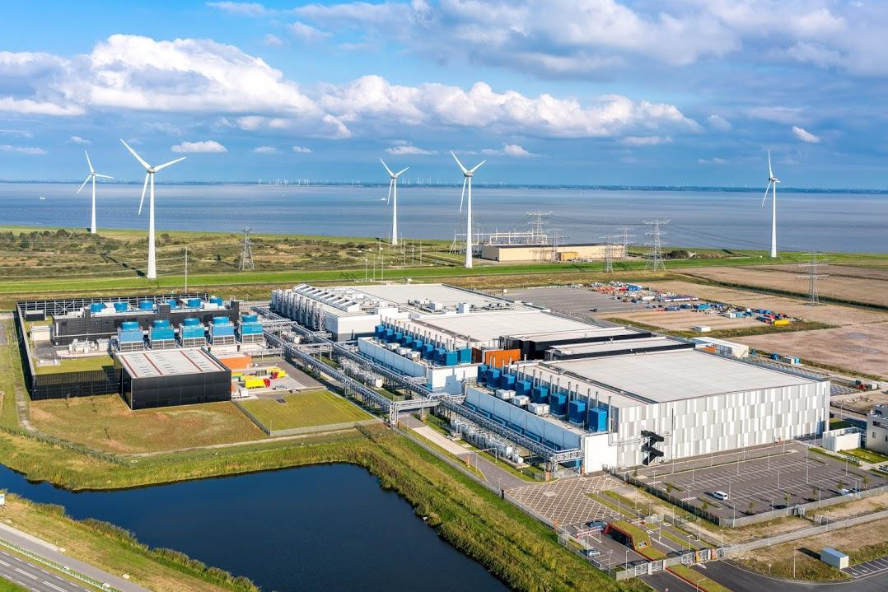
Location (or site)
It would seem that the site you choose for your data center would be considered one of the essential criteria. It's true that where you choose to locate the data center site (region/building) is important, but this choice is based on many different factors.
Also, connectivity through the company's network infrastructure has made it possible for a data center to be located wherever it is practical and affordable. A data center can even use multiple locations, if necessary, connecting through the network. In this way, location is a very flexible and negotiable criteria.
12

Slide 13
Essential criteria
All data centers must have the following four elements in whatever capacities are needed or available :
 Physical capacity: You must have space and weight capacity for equipment, and therefore, the other three criteria. There must be space for the equipment and the floor must be able to support the weight. This is a constant.
 Power: Without power nothing can run . Power is either on or off. Connections to different parts of the grid and/or utilizing a UPS increases uptime. You must have physical capacity to have room for power and the equipment that needs power.
 Cooling: Without cooling nothing will run for long. This is either on or off, though redundancy increases uptime. You must have physical capacity and power to run HVACs.
 Bandwidth: Without connectivity, the data center is of little value. The type and amount of bandwidth is device dependent. You must have physical capacity, power, and cooling to even consider connectivity.
13

Slide 14
Secondary criteria
 The essential criteria must be included in the design in whatever values are available. However, there are invariably other criteria that must be considered, but they are secondary. The level of importance of secondary criteria is wholly dependent on the company and project scope. Examples of secondary criteria are:
 Fixtures such as plumbing and lighting
 Walls, doors, windows, offices, loading dock
 All of the miscellaneous hardware, security cameras, card readers, door knobs,
 equipment cabinets, etc.
 Equipment such as forklifts and pallet jacks
 A Command Center
14

Slide 15
System Availability Profiles
The availability needs of the data center equipment should be determined in the project scope. Knowing which devices, or groups of devices, are mission-critical (needed 24×7×365) and which devices are in any availability level below mission-critical is important in determining many aspects of data center design, primarily system redundancies. These include:
 Device Redundancies :The number of backup devices that must be available in the event of equipment failures.
 Power Redundancies : The number of feeds from different parts of the grid, the number of UPS systems, etc., that must be installed to make sure these systems stay running.
 Cooling Redundancies : The number of extra HVAC units that must be available in the event that one or more units fail.
15
 Network Redundancies : The amount of network equipment that must be available in the event of failure. The number of connections to your ISP. The number of network feeds needed to multiple ISPs in the event that one has a catastrophic failure.

Slide 16
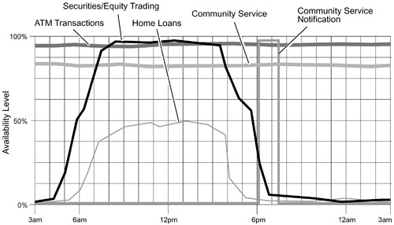
In most situations, a data center won't have a single availability
profile. Several jobs could be going on from machine to
machine, and some tasks have greater availability levels than
others, some highly critical. Some might need to be highly
available, but are less critical. Determining risk of all the operations is key to making many design decisions.
 ATM transactions which are highly utilized (mission-critical)
must be available around the clock. Redundant systems are essential.
 Security and equities trading must be constantly available
during business hours (mission-critical) and moderately
available the remaining parts of the day. Redundant systems are essential.
 Home loans are important but some occasional downtime
won't be disastrous. Redundancy is a good idea, though this is where corners can be cut.
 The Community Services Web site should be up and running
around-the-clock so people can access the information, but
this is a non-critical service and some downtime won't hurt. Redundancy is probably not worthwhile.
 The Community Services email mailers are sent only once a
week in the evening and, though important, it won't hurt the
company if the mailers go out late on occasion. No redundancy is required.

Slide 17
3.Designing a Data Center
17
Data center design consider as one of the complicated project that required very high skilled team to work on it, following some of the key factor related to data center design that need to be follow for the entire project life cycle.
Design Process.
Data Center Structural Layout.
Data Center Support Systems.
Physical and Logical Security.
System Monitoring.
Remote Systems Management.
Planning for Possible Expansion.

Slide 18
Design Process
 The design stages for the data center usually take the skills of Architects, Accountants, Structural, Mechanical, Electrical, HVAC, System, and Network engineers, Project managers, and Procurement personnel. Add also the probability of sales personnel, insurance carriers, and risk management analysts
 Overseeing the project is a data center design engineer whose task is to accommodate the requirements of the system and network engineers, and to work with the other members of the team to ensure that the data center requirements (based on the project scope) are met.
18

Slide 19
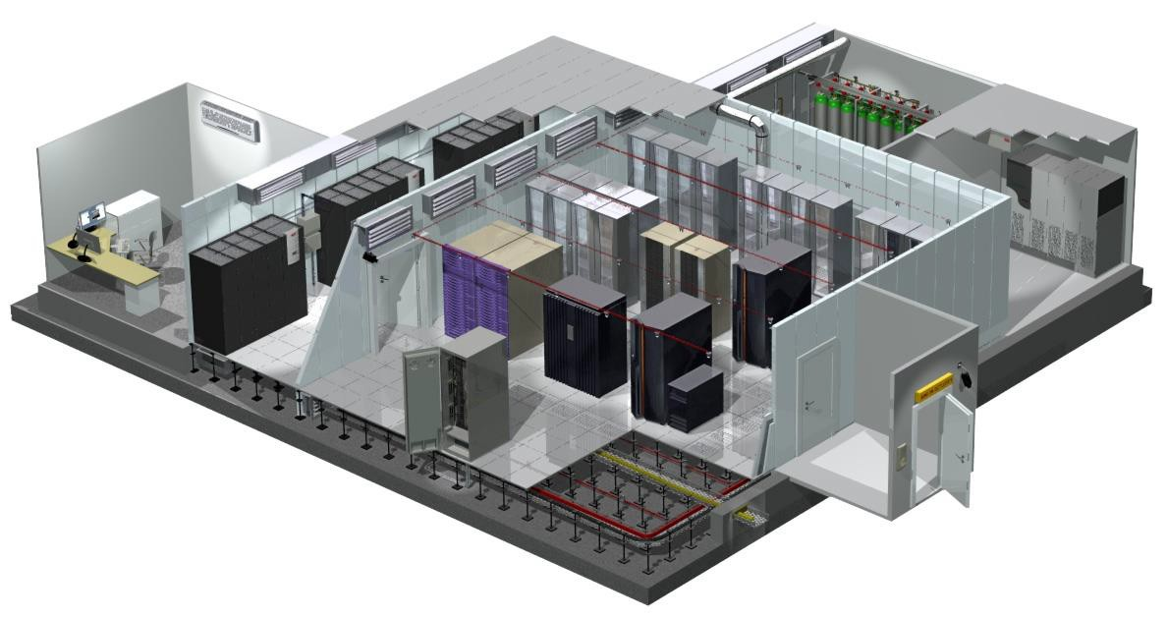
Data Center Structural Layout
19
 The data center must be designed to accommodate diverse hardware designs and requirements, and possibly equipment from different manufacturers. Determining RLUs is the best way to decide how the space will be filled with equipment, and with this information, where the equipment will be placed. The following general guidelines should be used in planning the initial layout of the room, keeping future planning in mind.

Slide 20
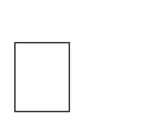
Structural Considerations
 Building in an area with a subfloor to ceiling height of ten feet
 Building in the basement of a building that overlooks a river
 Building in the 43rd floor of a high rise building along the San
Andreas fault line
 Building in a space with the restrooms built right in the middle
 Aisles aren’t wide enough for newer or bigger machines
 Not knowing the structural load rating of raised floors and ramps
20

Slide 21
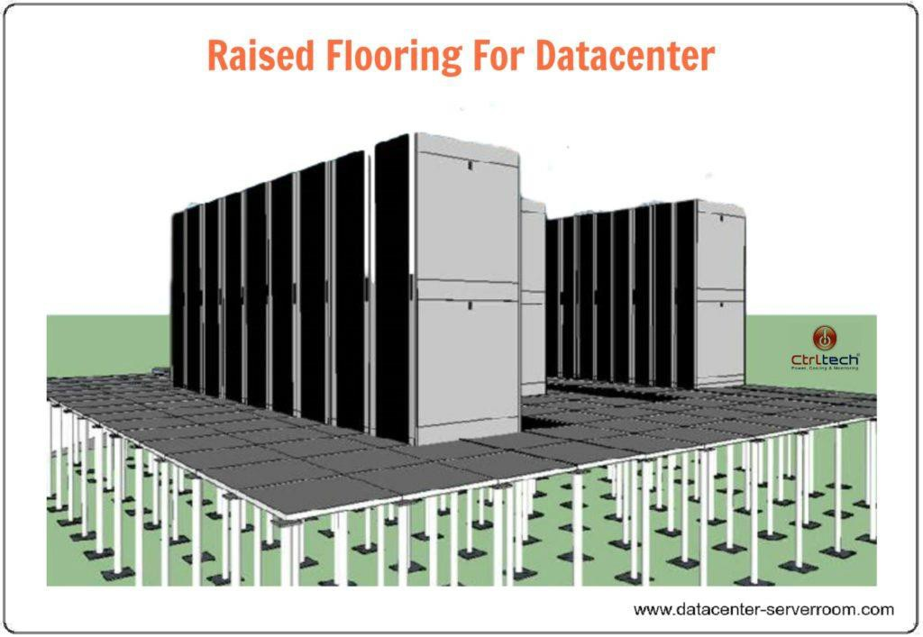
Raised Floor
 A raised floor is an option with very practical benefits. It provides flexibility in electrical and network cabling, and air conditioning.
21

Slide 22
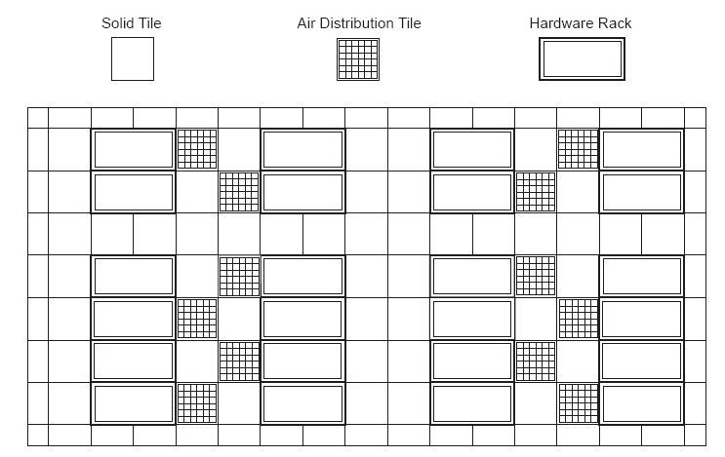
Aisles and Other Necessary Open Space
22
Aisle space should allow for unobstructed passage and for the replacement of racks within a row without colliding with other racks. The optimal space would allow for the turn radius required to roll the racks in and out of the row
Also, rows should not be continuous. Unbroken rows make passage from aisle to aisle, or from the front of a rack to the back, very time consuming

Slide 23
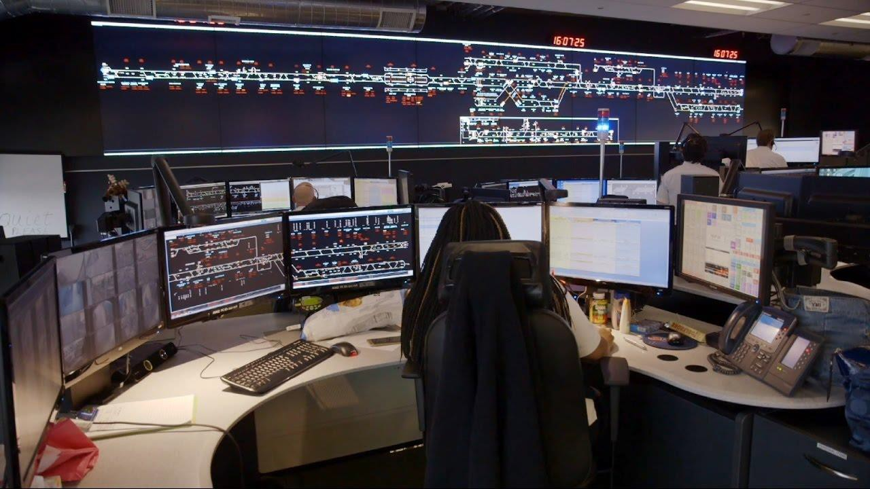
Command Center
 Though an optional consideration, for some companies a separate Command Center (also called a Command and Control Center) is useful for controlling access to the consoles of critical systems. This is just one of the many security devices used in the data center.
 In disaster recovery scenarios or other critical times, the Command Center is a key area. In many corporations where computer technology is at the core of their business, this Command Center also serves as a “war room” in times of crisis.
23

Slide 24
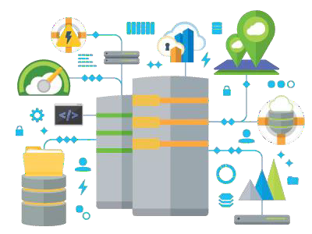
Data Center Support Systems
A data center must provide certain services:
 Locations on the floor that can support the weight of the racks
 Power to run the racks
 Cooling to keep the racks from overheating
 Connectivity to make the devices in the
racks available to users
 Planned redundancies
28

